Slide 1

`
The Impact of Artificial Intelligence and Machine Learning on the Banking Sector
IT - 10
Information Technology & Analytics
Ravi Kumar Jain, Indian Institute of Foreign Trade
Dr. Anju Goswami, Indian Institute of Foreign Trade

Slide 2
Session Plan
Objectives
Methodology
Data Analysis & Findings
Thematic Analysis
Implications of the Study
Research Limitations & Conclusion
References (in APA Style)

Slide 3
Objectives
Examine AI/ML use in banking:
Risk Management
Performance
Identify Emerging trends:
Improving decision making,
Risk detection,
Customer insights
Explore Research gaps:
ethical AI,
unsupervised learning,
real time systems

Slide 4
Methodology
Database Selection
Scopus
Keyword Search
“Banking" and “Artificial Intelligence“ and “Machine Learning”
PRISMA Framework
Bibliometric Analysis
Biblioshiny
VOSviewer
Shortlisted Research Papers
Thematic Analysis
Nvivo
Detail Analysis
Conclusion
Further Research Opportunities
Emerging Trends

Slide 5
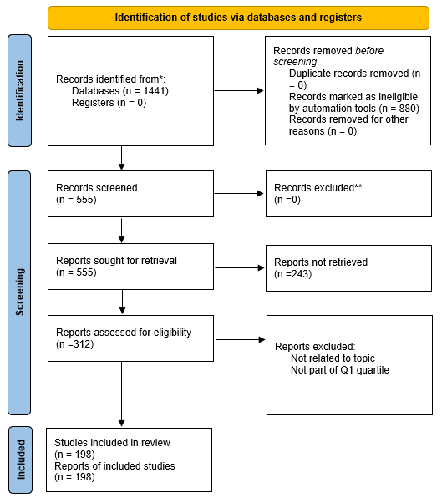
PRISMA Flow Diagram
Initial pool: 1,441 records identified.
Automated screening removed 880 irrelevant/duplicate entries.
243 records unavailable, leaving 312 reports for eligibility assessment.
Final selection: 198 high-quality studies based on topic relevance and Q1 quartile.

Slide 6
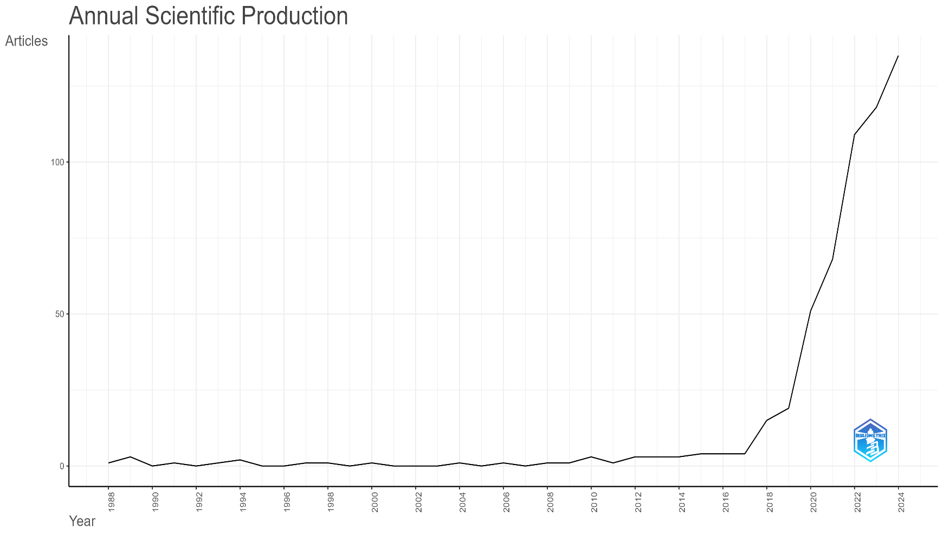
Annual Scientific Production
Research output remained low and stable from 1988 to 2016.
A sharp increase in publications from 2017 onward.
Reflects growing interest and advancements in AI/ML for banking applications.

Slide 7
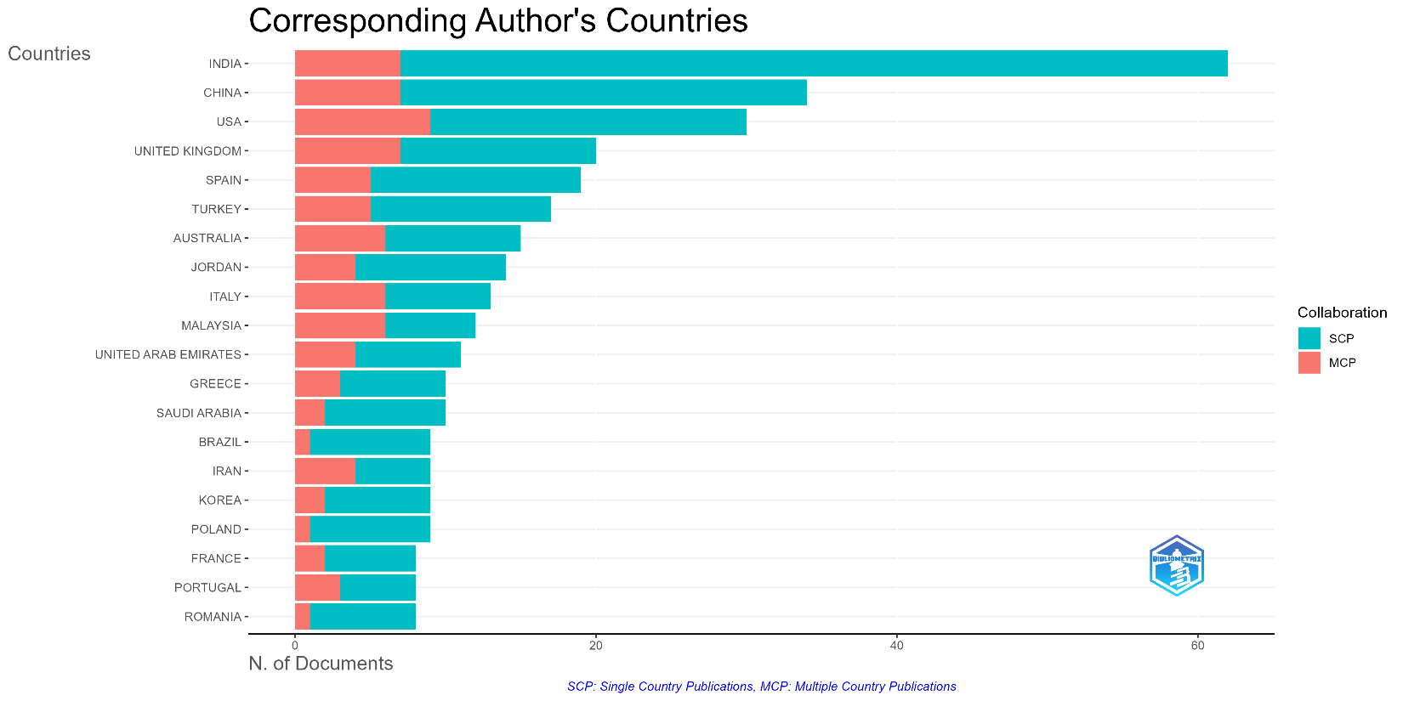
Corresponding Author’s Countries
India and China show strong domestic research efforts.
USA and UK exhibit balanced collaboration with multiple-country publications.
SCP: Single Country Publication
MCP: Multiple Country Publication

Slide 8
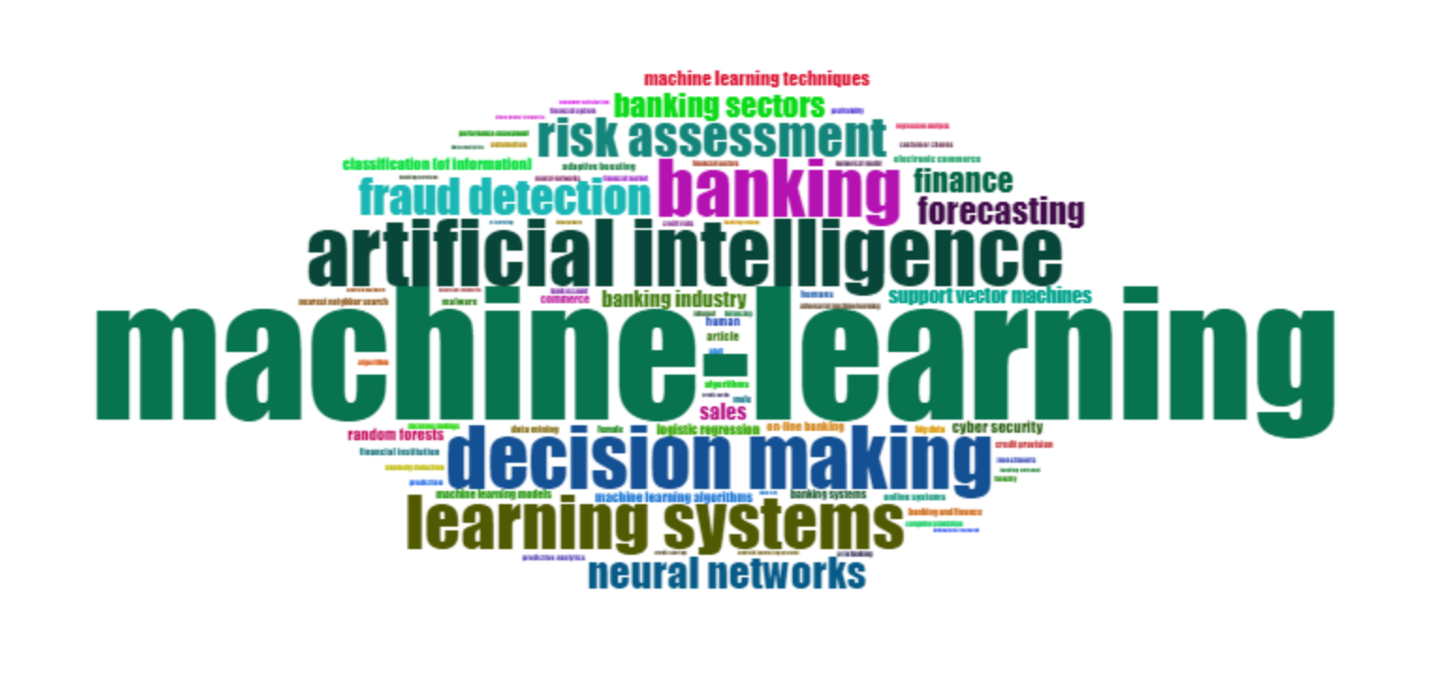
Word Cloud

Slide 9
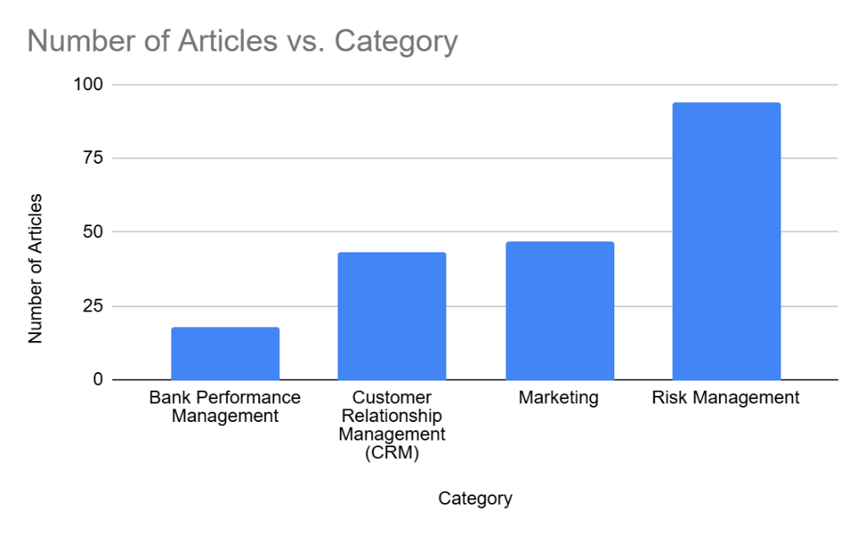
AI / ML in Banking: Categories and Sub-Categories
Category | Sub-Category | Number of Articles
Bank Performance Management | Predictive analytics, Portfolio and wealth management, Performance reporting, Compliance tracking | 18
Customer Relationship Management (CRM) | Customer churn prediction and retention, Customer service automation and personalization, Portfolio and wealth management | 43
Marketing | Cross-selling, Customer segmentation, Technology adoption, Technology critique, Predictive analytics and market forecasting | 47
Risk Management | Credit risk management, Fraud detection and anti-money laundering (AML), Bank failure prediction, Liquidity risk, Operational risk, Systemic risk management, Portfolio and wealth management, Operational efficiency and process automation, Regulatory compliance and risk management | 94

Slide 10
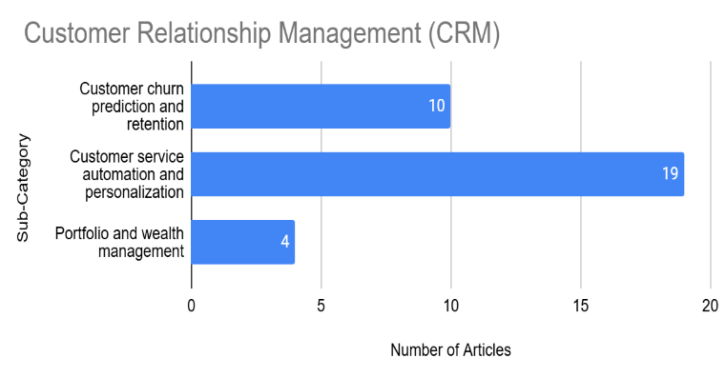
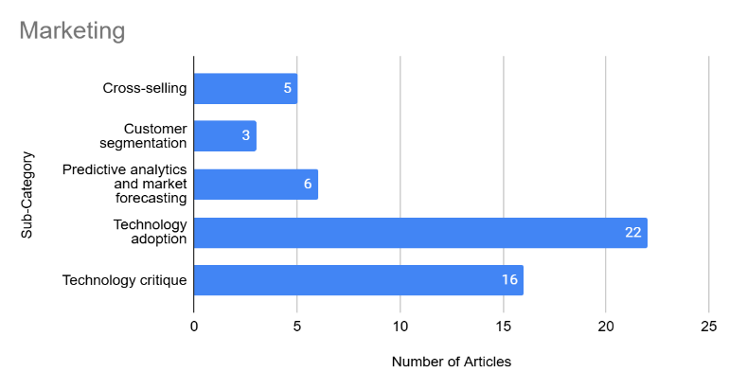
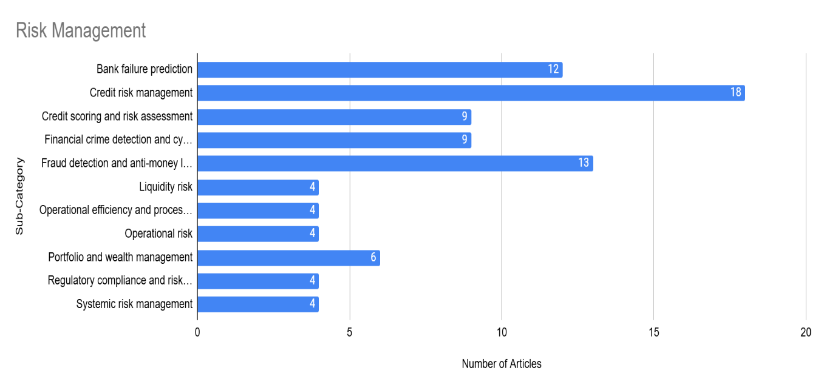
AI / ML in Banking: Categories and Sub-Categories

Slide 11
Customer Churn Use Case

Slide 12
Objective
Enhance churn prediction accuracy on bank customer data.
Dataset Summary
Source: U.S. Bank Customer Churn dataset (Kaggle)
Records: 10,000 customers
Features: 17 predictors + 1 target (Exited)
Preprocessing:
Removed identifiers
Encoded categorical features
Handled class imbalance with SMOTE
Split: 75% training / 25% testing

Slide 13
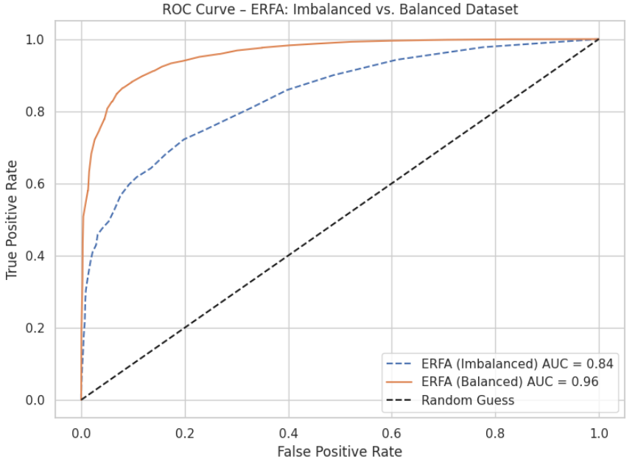
Customer Churn - Use Case
Balanced vs Imbalanced dataset

Slide 14
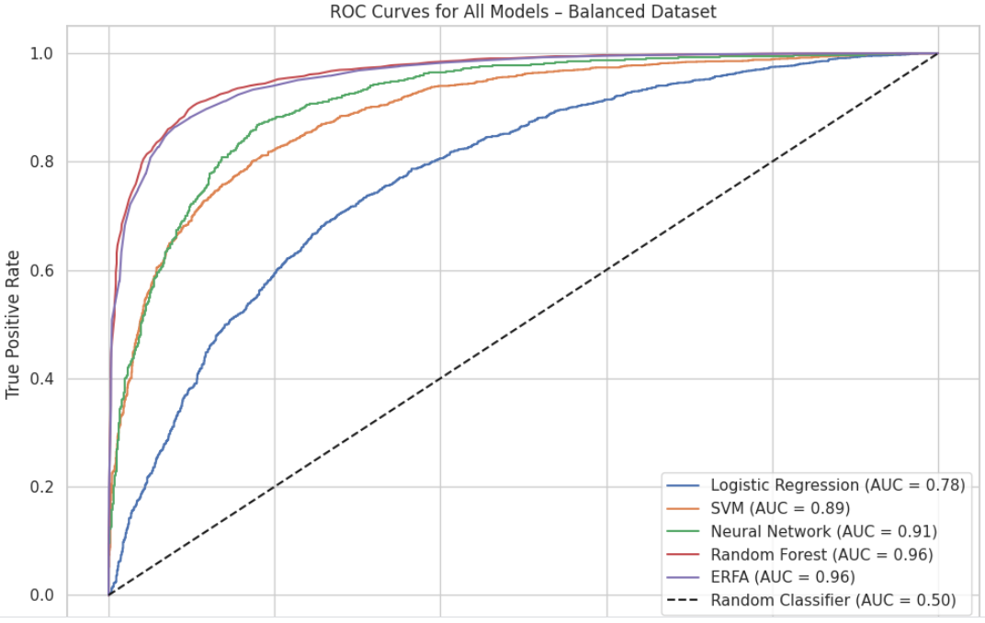
Customer Churn - Use Case
Enhanced Random Forest vs other models

Slide 15
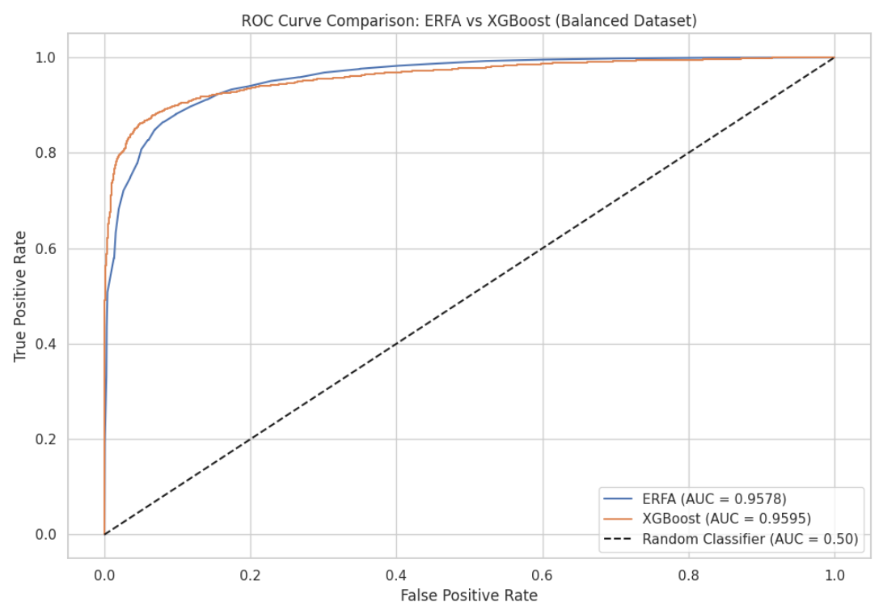
Customer Churn - Use Case
Enhanced Random Forest vs XGBoost

Slide 16
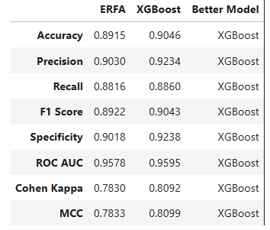
Enhanced Metric Comparison Table: ERFA vs. XGBoost (Balanced Dataset)
XGBoost is better in 8 out of 8 metrics.

Slide 17
Conclusion

Slide 18
Conclusion: Key Applications
Improves fraud detection, credit risk management, and customer service.
Anomaly detection enabling real-time fraud prevention.
Enhance customer churn management
Chatbots and virtual assistants improve customer engagement

Slide 19
Conclusion: Emerging Trends
Adoption of cybersecurity-focused AI
Explainable AI (XAI) to improve transparency
Regulatory compliance automation
Predictive analytics are advancing

Slide 20
Research Gaps in AI/ML for Banking
Unsupervised Learning
Ethical Concerns
Real-Time Systems
Explainability

Slide 21
References
Tavana, M., Abtahi, A.-R., Di Caprio, D., & Poortarigh, M. (2018). An Artificial Neural Network and Bayesian Network model for liquidity risk assessment in banking. Neurocomputing, 275, 2525–2554. https://doi.org/10.1016/j.neucom.2017.11.034
Kalyani, S., & Gupta, N. (2023). Is artificial intelligence and machine learning changing the ways of banking: A systematic literature review and meta-analysis. Discover Artificial Intelligence, 3(1), Article 1. https://doi.org/10.1007/s44163-023-00094-0
Hassani, H., Huang, X., Silva, E., & Ghodsi, M. (2020). Deep Learning and Implementations in Banking. Annals of Data Science, 7(3), Article 3. https://doi.org/10.1007/s40745-020-00300-1
Malhotra, P. (2024). The rise of passive investing: a systematic literature review applying PRISMA framework. Journal of Capital Markets Studies. https://doi.org/10.1108/jcms-12-2023-0046
O'Neill, M., Booth, S., & Lamb, J. (2018). Using NVivo for Literature Reviews: The Eight Step Pedagogy (N7+1). The Qualitative Report. https://doi.org/10.46743/2160-3715/2018.3030
Fethi, M. D., & Pasiouras, F. (2010). Assessing bank efficiency and performance with operational research and artificial intelligence techniques: A survey. European Journal of Operational Research, 204(2), Article 2. https://doi.org/10.1016/j.ejor.2009.08.003
Khandani, A. E., Kim, A. J., & Lo, A. W. (2010). Consumer credit-risk models via machine-learning algorithms. Journal of Banking and Finance, 34(11), Article 11. https://doi.org/10.1016/j.jbankfin.2010.06.001

Slide 22
Important Instructions
The Time limit for paper presentation is 15 Minutes (10-12 min. for presentation + 2-3 min. for Q&A).
The Presentation should be in MS-Power point (PPT) only.
Mention the Conference Name: GBRC 2025; Paper ID ; Presenter and Co-authors name and Affiliation.
Minimal text and Maximum Illustration are recommended .
Image / Figures; tables; Info-graphics can be used however audio and Video may be avoided.
Save PPT File Name as: Paper ID and Track No. (For Ex- Track -1-FM)
Kindly upload the PPT on the Google Drive Folder for easy access during conference days.
Please join your respective technical session well on time.

Slide 23
`
<Title of the Paper>
<Paper ID>
<Track Name>
<Name of Paper Presenter & Affiliation >
<Name of Co-Authors & Affiliation>

Slide 24
Session Plan
Purpose/Objectives
Literature Review (Tabular format)
Study Design/Methodology/Approach
Data Analysis & Findings
Originality
Implications of the Study
Research Limitations & Conclusion
References (in APA Style)

Slide 25
Important Instructions
The Time limit for paper presentation is 15 Minutes (10-12 min. for presentation + 2-3 min. for Q&A).
The Presentation should be in MS-Power point (PPT) only.
Mention the Conference Name: GBRC 2025; Paper ID ; Presenter and Co-authors name and Affiliation.
Minimal text and Maximum Illustration are recommended .
Image / Figures; tables; Info-graphics can be used however audio and Video may be avoided.
Save PPT File Name as: Paper ID and Track No. (For Ex- Track -1-FM)
Kindly upload the PPT on the Google Drive Folder for easy access during conference days.
Please join your respective technical session well on time.

